Slide 1
DSD Final Project Presentation
Group 8
Member: 陳柏帆 洪鈺萌 林志皓

Slide 2
Contents
MIPS pipeline (baseline)
Cache design
Extention1 -- Branch Prediction
Extention2 -- Tow Level Cache
Extention3 -- Multiplication & Division

Slide 3
1.
MIPS Pipeline

Slide 4
structure
Hand-drawn by
柏帆

Slide 5
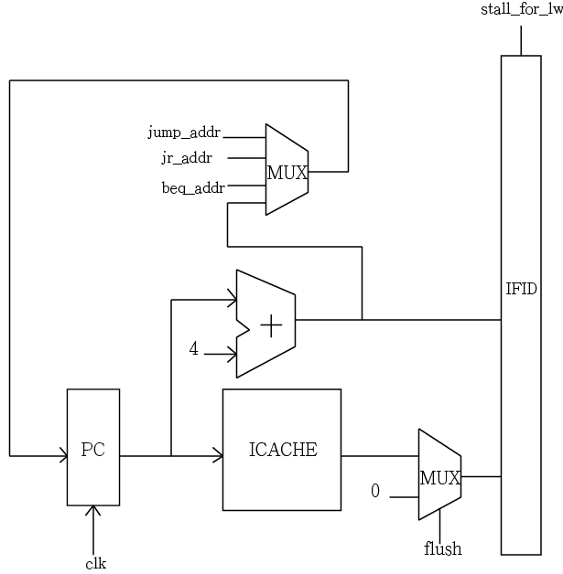
Instruction Fetch
Select next Instruction address
(jump/ branch/ PC+4)
When next address is not PC+4 , we set a “FLUSH”
(32’b0 for instruction)

Slide 6
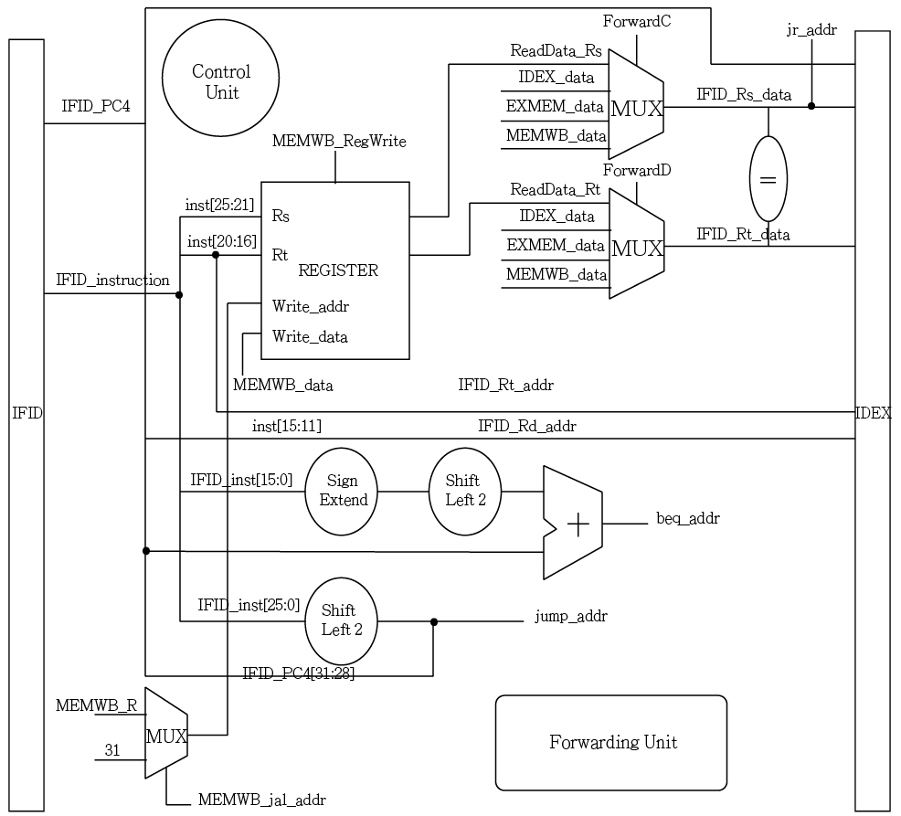
Instruction Decode
Control unit
Forwarding Unit
Determine whether Branch or not

Slide 7
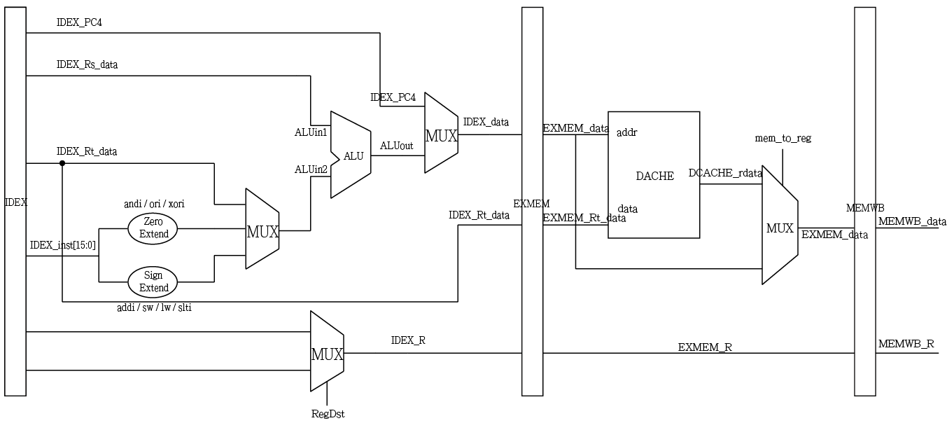
EX, MEM, WB
Select the data to be forward in MEM stage (from ALU or memory)
→ Simplified forwarding unit

Slide 8
2.
Cache

Slide 9
Structure
Direct-map( 4 words * 8 block)
Write-back
Valid bit (no dirty bit)
Valid bit 1 bit | Tag 25 bits | DATA 1 32 bits | DATA 2 32 bits | DATA 3 32 bits | DATA 4 32 bits
A block

Slide 10
Finite State Machine
Write or Read hit
Idle
Only 3 states !
If hit, processor can get data from cache in the cycle of request
→ Reduce total cycle
Ready
Need to
Write Back
Read miss
& valid
Read from
memory
Write
Back
Ready
Not ready
Not ready

Slide 11
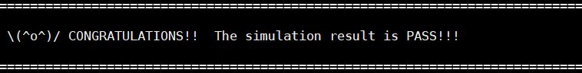
Baseline Performance
Cell Area : 284158
Execution Time : 9960.75 (ns)
AT rate : 2830426799

Slide 12
3.
Extention –
Branch Prediction

Slide 13
Finite State Machine
Initially, the IDLE state is Strongly Not Taken
If prediction wrongly two times in a row, the state will go to Taken
Strongly
Not Taken
Weakly
Not Taken
Weakly
Taken
Strongly
Taken

Slide 14
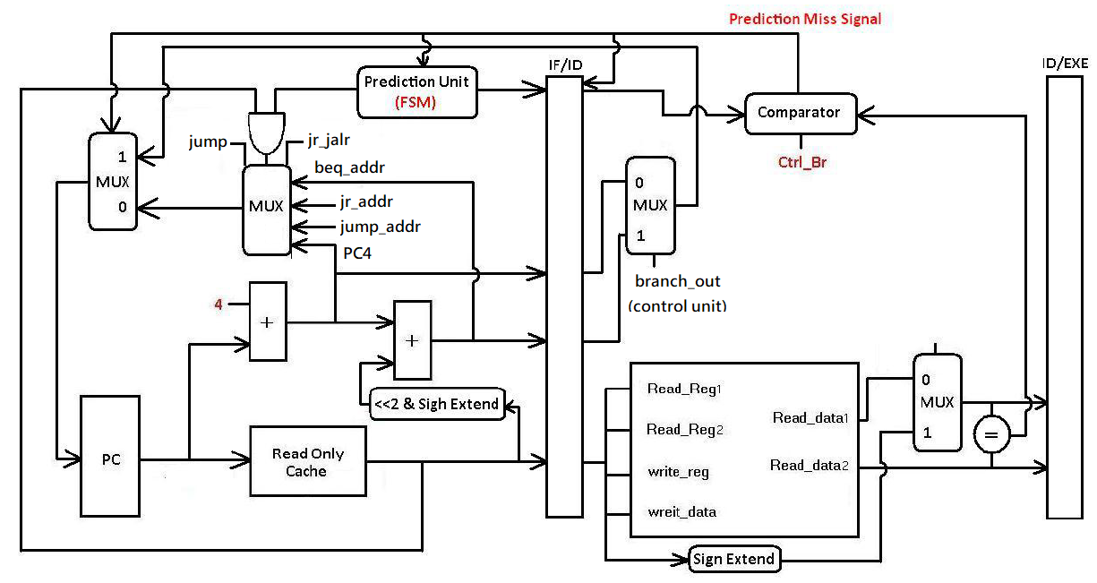
Overall Circuit

Slide 15
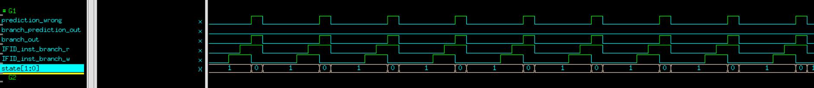
Result
Cannot predict two successive branch instructions effectively
1234568

Slide 16
4.
Extention –
Two Level Cache

Slide 17
Implementation Details
Separate 2 L2 caches for I cache & D cache
Direct Map
4 words/block, total 64 blocks(entries)
FSM: 3 state
Valid 1 bit | Tag 22 bits | Data 128 bits

Slide 18
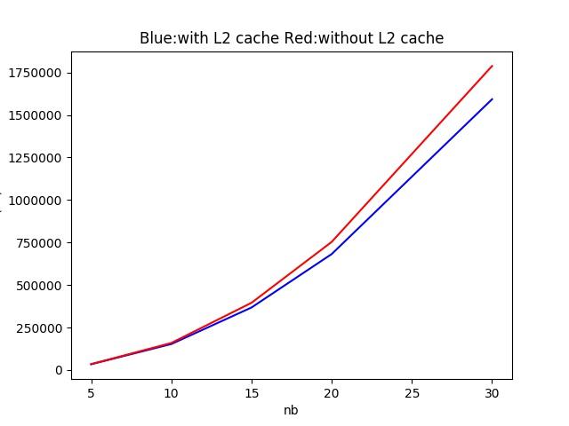
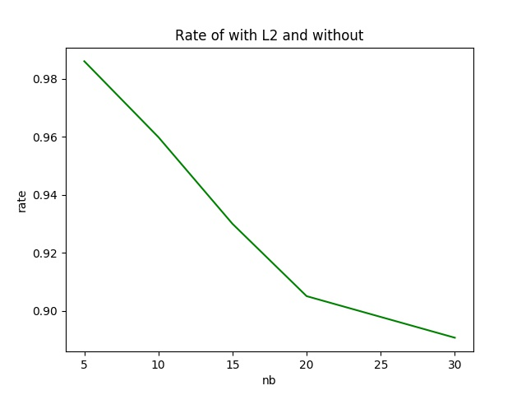
Result

Slide 19
5.
Extention –
Multiplication & Division

Slide 20
Implementation Details
Iterative, stall 32 cycles for each Multiplication/Division Instruction
Record the position of Add/Subtract with Counter,
Thus determine when to stop “stalling”
Correctness Verification :
Check data in D cache with monitoring nWave
Add some negative number for testing

Slide 21
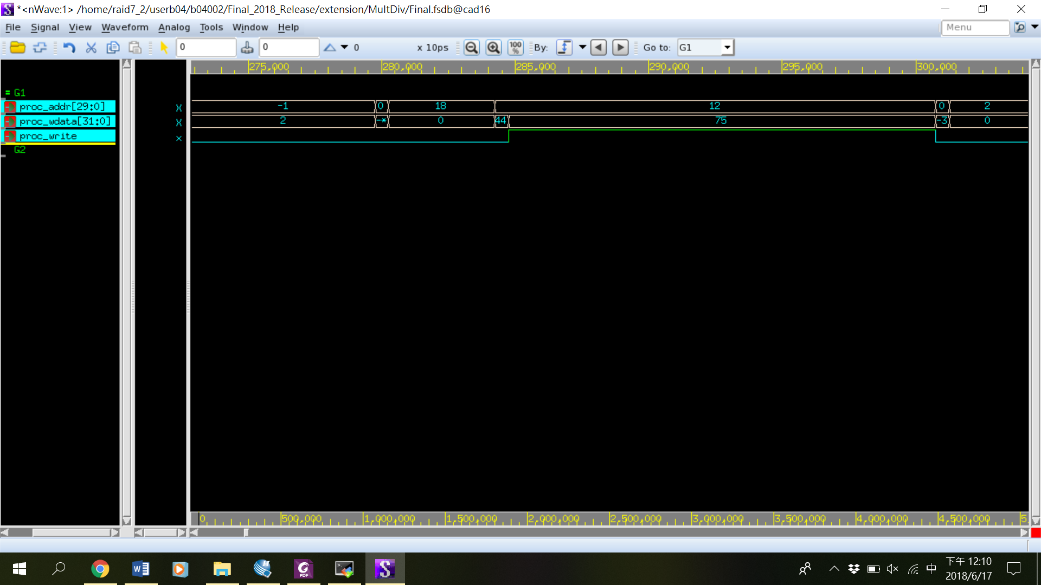
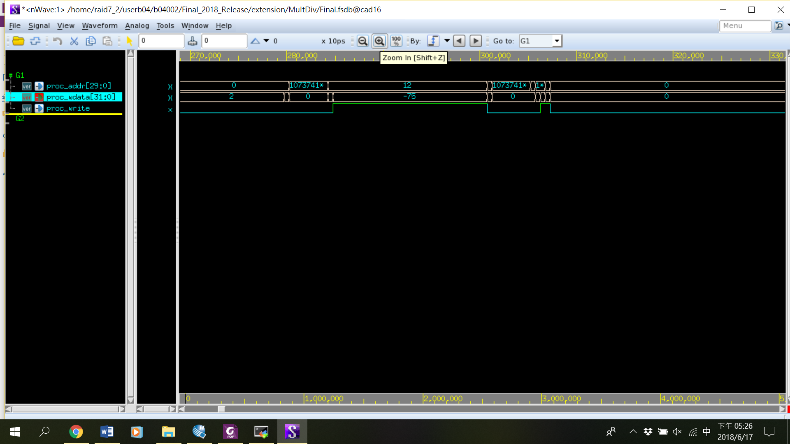
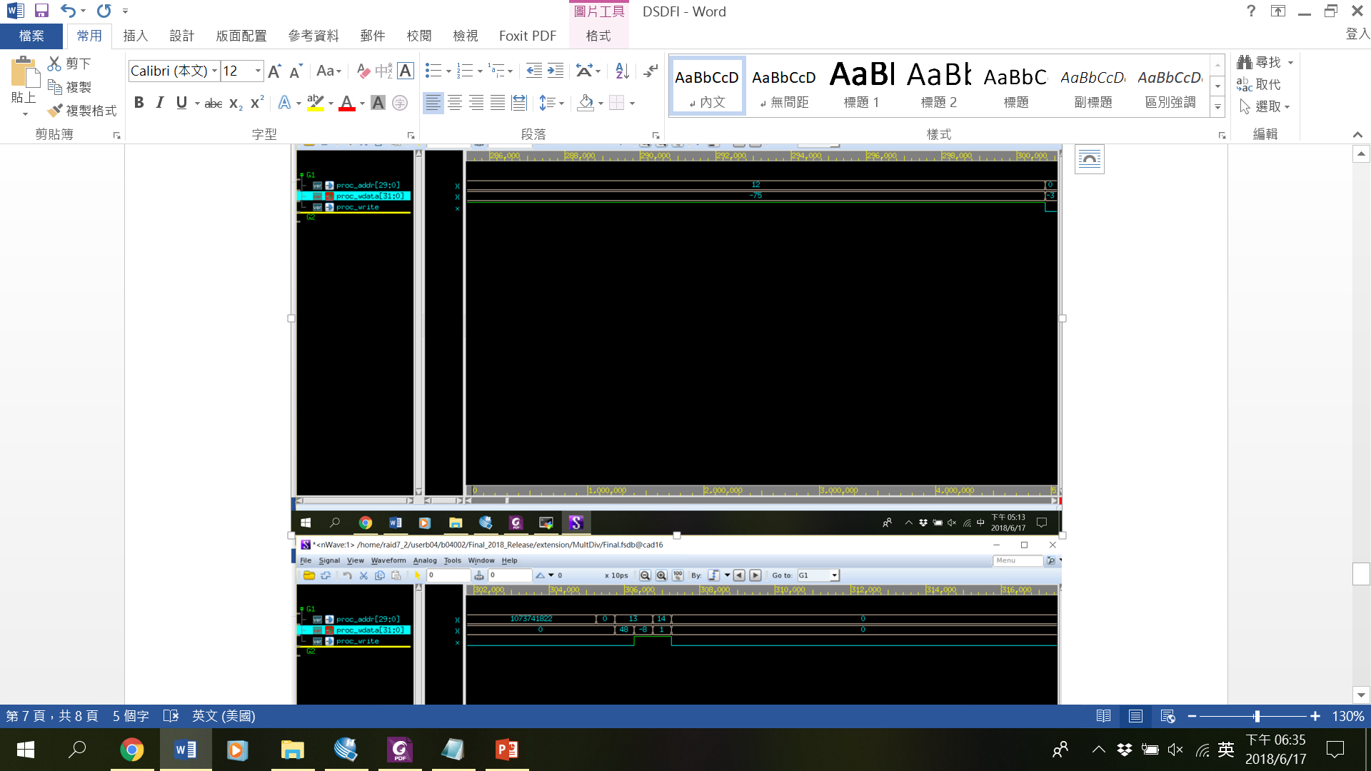
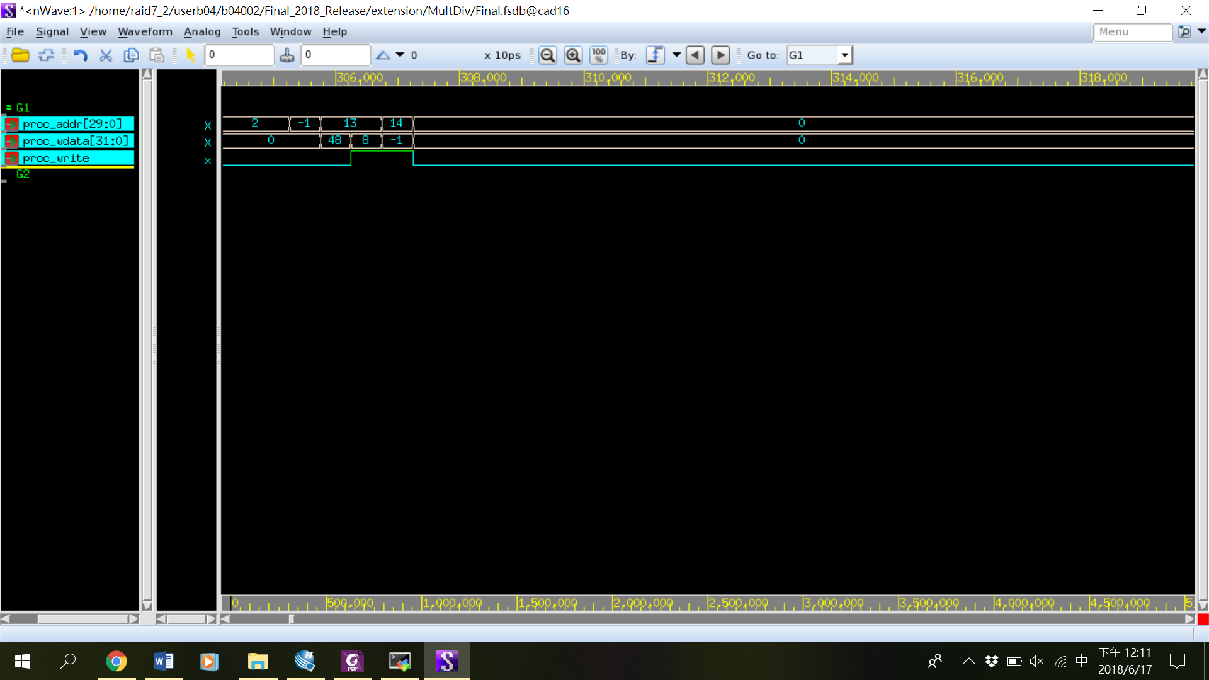
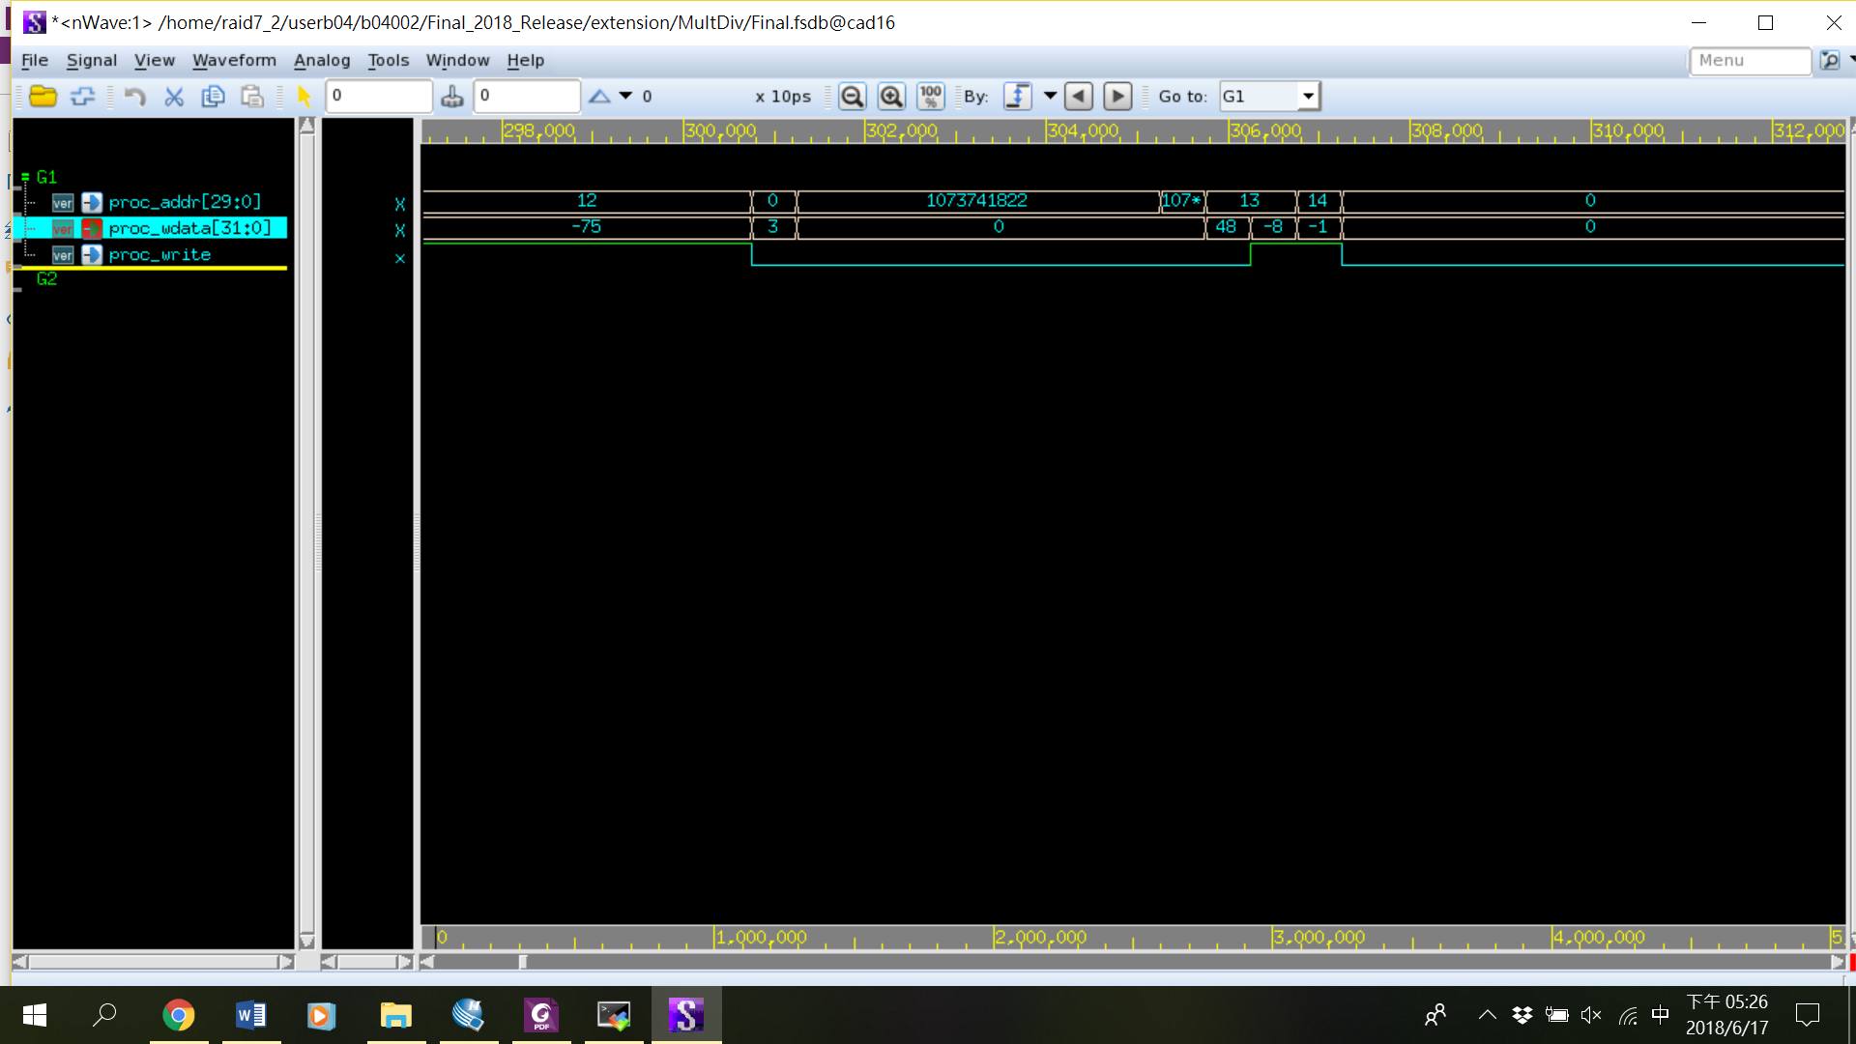
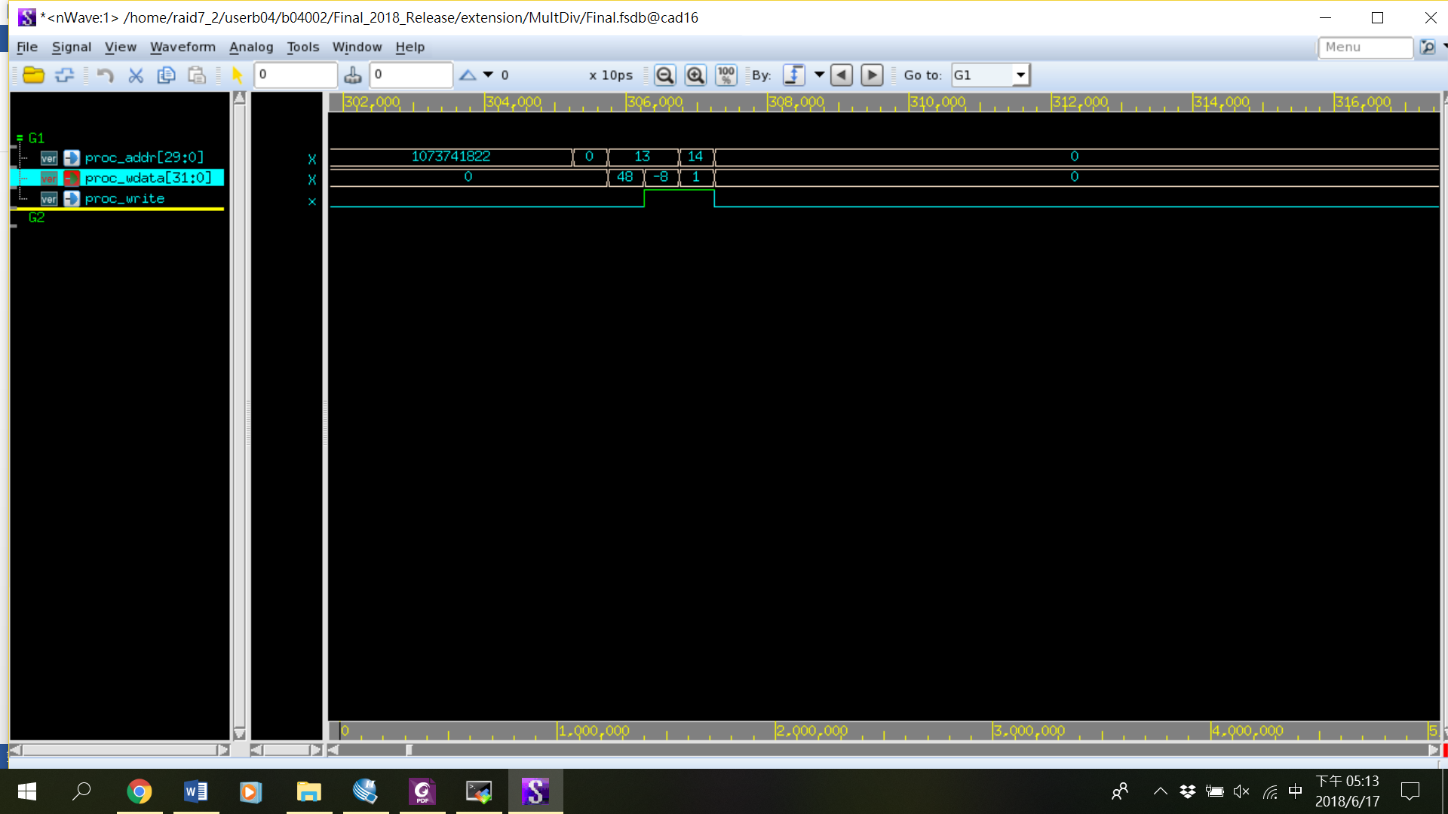
Result
Numbers to be Multiplication/Division | -25 -3 | -25 3 | 25 -3
Multiplication
Division

